Slide 1
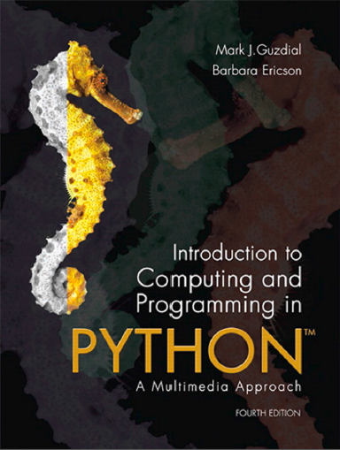
Introduction to Computing and Programming in Python™: A Multimedia Approach
Fourth Edition
Chapter 11
Manipulating Text with Methods and Files
Slides in this presentation contain hyperlinks. JAWS users should be able to get a list of links by using INSERT+F7
Copyright © 2016, 2013, 2010 Pearson Education, Inc. All Rights Reserved
Notes:
If this PowerPoint presentation contains mathematical equations, you may need to check that your computer has the following installed:
1) MathType Plugin
2) Math Player (free versions available)
3) NVDA Reader (free versions available)
Thanks to John Sanders of Suffolk University for contributions to these slides!

Slide 2
Learning Objectives (1 of 2)
11.1 To generate text in a form-letter style.
11.2 To manipulate structured text, such as phone and address listings.
11.3 To generate random structured text.
11.4 To access object components using dot notation.
11.5 To manipulate srtings.
11.6 To read and write files.
11.7 To understand file structures like trees.

Slide 3
Learning Objectives (2 of 2)
11.8 To write programs that manipulate programs, which leads to powerful ideas like interpreters and compilers.
11.9 To use the modules in the Python Standard Library, such as the random and o s utilities.
11.10 To get a sense of the functionality available in the Python Standard Library.
11.11 To broaden the understanding of the import capability.

Slide 4
Text
Text is the universal medium
We can convert any other media to a text representation.
We can convert between media formats using text.
Text is simple.
Like sound, text is usually processed in an array—a long line of characters
We refer to one of these long line of characters as strings.
In many (especially older) programming languages, text is actually manipulated as arrays of characters. It’s horrible! Python actually knows how to deal with strings.

Slide 5
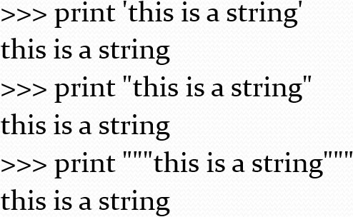
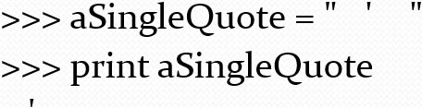
Strings
Strings are defined with quote marks.
Python actually supports three kinds of quotes:
Use the right one that allows you to embed quote marks you want

Slide 6
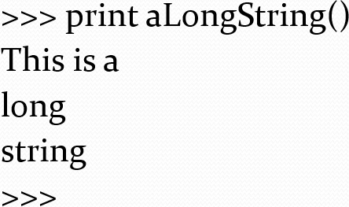
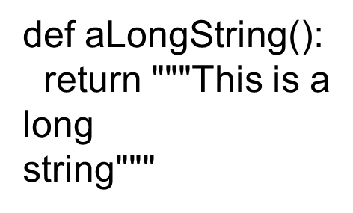
Why Would You Want to Use Triple Quotes?
To have long quotations with returns and such inside them.

Slide 7
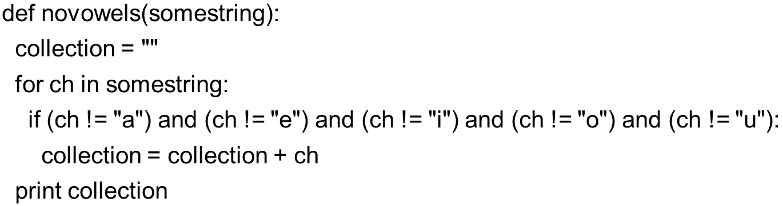
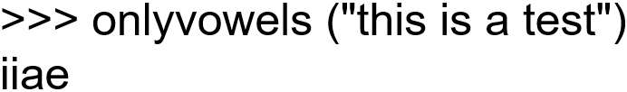
Remember This Function (1 of 2)
Notes:
#2

Slide 8




Remember This Function (2 of 2)
If you wanted Only vowels, what would you change in the I F?
(1) Change all != to ==
(2) Change all != to == AND change all “and” to “or”
(3) Change all “and” to “or”
(4) Keep the same != and “and” structure, but list all 21 consonants

Slide 9
Getting Parts of Strings (1 of 2)
We use the square bracket “[]” notation to get parts of strings.
string[n] gives you the n^{th} character in the string
string[n:m] gives you the n^{th} up to (but not including) the m^{th} character.

Slide 10
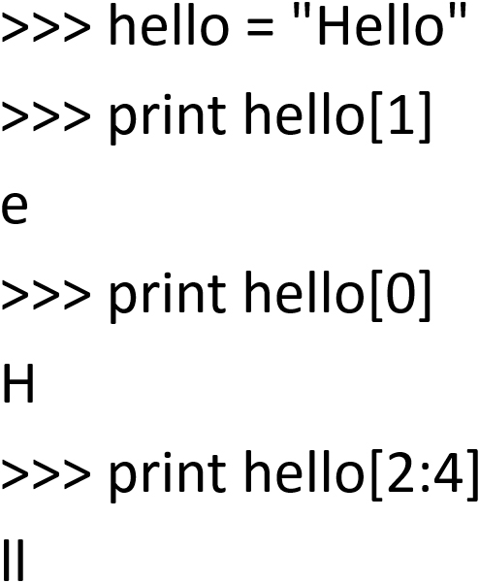
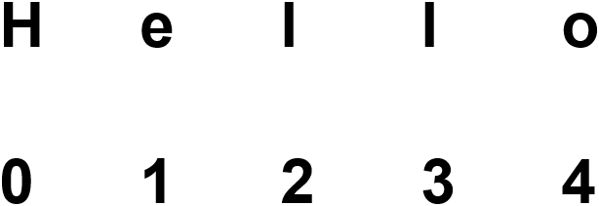
Getting Parts of Strings (2 of 2)

Slide 11
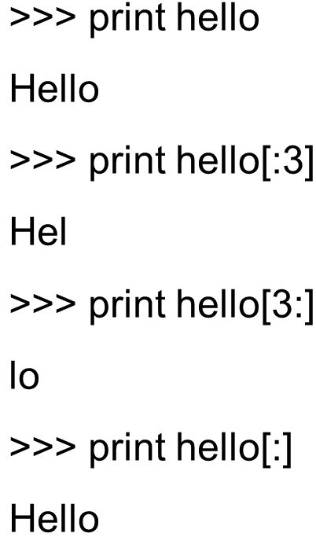
Start and End Assumed if not There

Slide 12
Dot Notation
All data in Python are actually objects
Objects not only store data, but they respond to special functions that only objects of the same type understand.
We call these special functions methods
Methods are functions known only to certain objects
To execute a method, you use dot notation

Slide 13
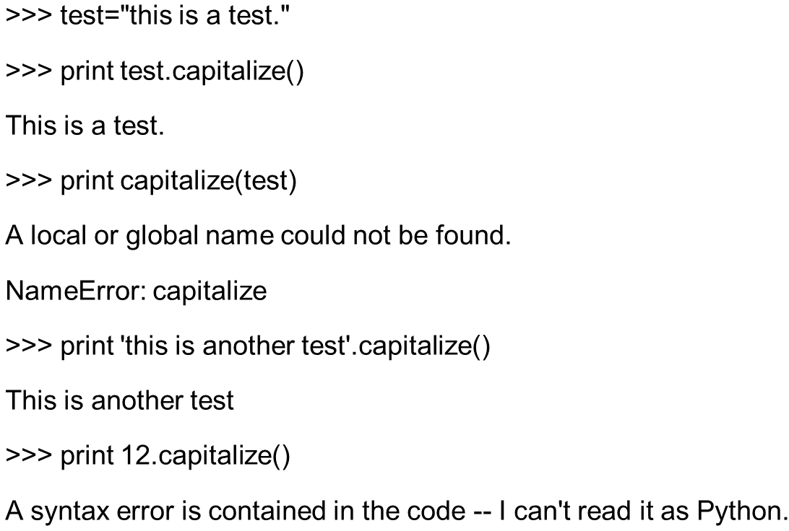
Capitalize is a Method Known Only to Strings

Slide 14
Useful string methods
startswith(prefix) returns true if the string starts with the given suffix
endswith(suffix) returns true if the string ends with the given suffix
find(findstring) and find(findstring,start) and find(findstring,start,end) finds the findstring in the object string and returns the index number where the string starts. You can tell it what index number to start from, and even where to stop looking. It returns -1 if it fails.
There is also rfind(findstring) (and variations) that searches from the end of the string toward the front.

Slide 15
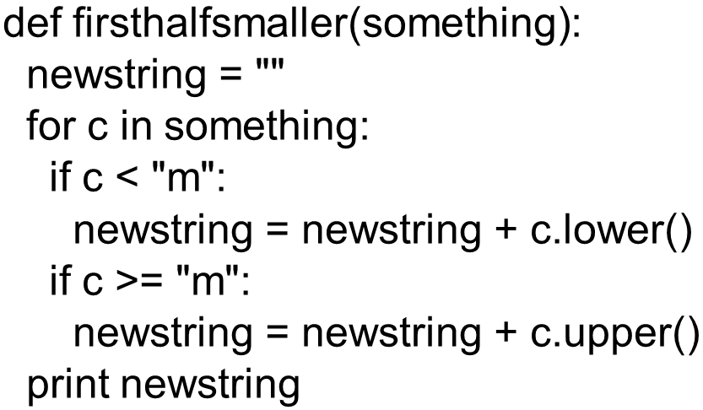
Consider This Function (1 of 2)
If I call it like this: firsthalfsmaller(“this is a test”)
Notes:
#1. #2 is opposite. #3 is position based, but we can do that.

Slide 16
Consider This Function (2 of 2)
Which one of these is the output?
(1) ThiS iS a TeST
(2) tHIs Is A tEst
(3) this is A TEST
(4) THIS IS a test

Slide 17
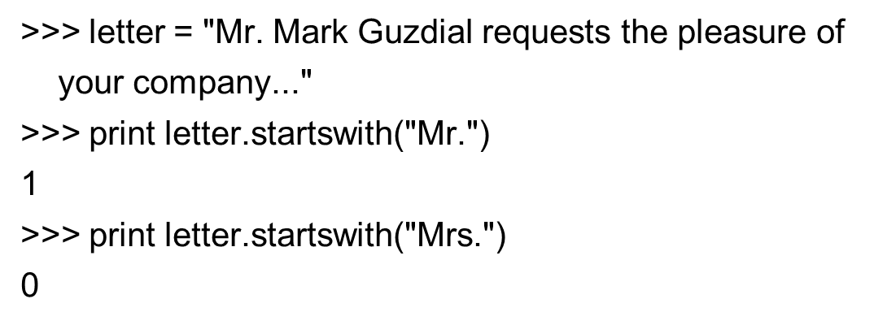
Demonstrating Startswith
Remember that Python sees “0” as false and anything else (including “1”) as true

Slide 18
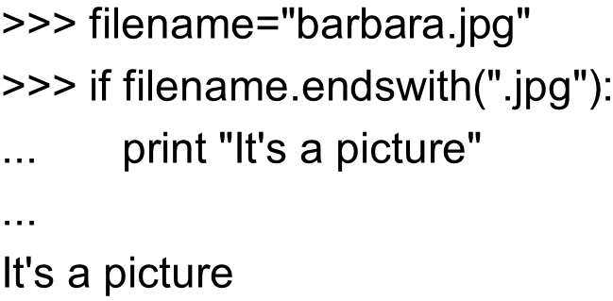
Demonstrating Endswith

Slide 19
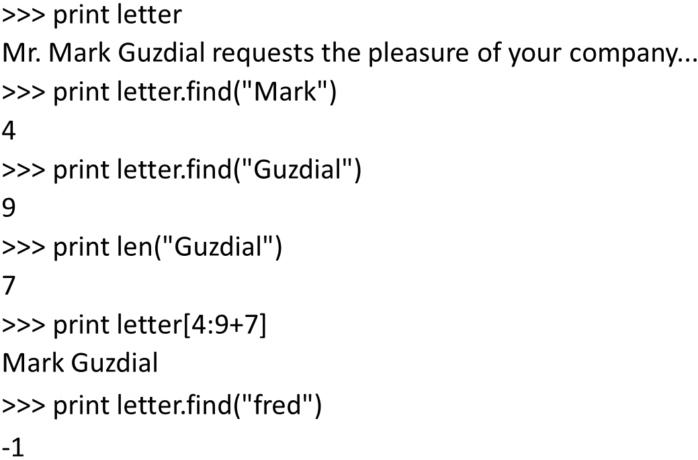
Demonstrating Find

Slide 20
Interesting String Methods
upper() translates the string to uppercase
lower() translates the string to lowercase
swapcase() makes all upper→lower and vice versa
title() makes just the first characters uppercase and the rest lower.
isalpha() returns true if the string is not empty and all letters
isdigit() returns true if the string is not empty and all numbers
Notes:
Do all of these in the command area

Slide 21
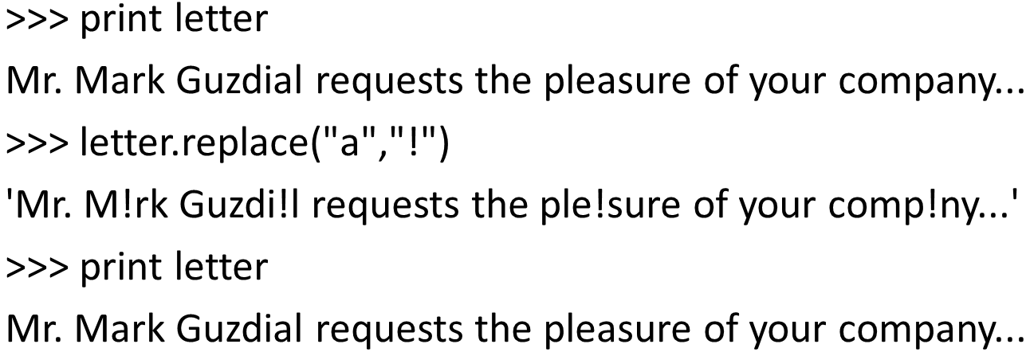
Replace Method

Slide 22
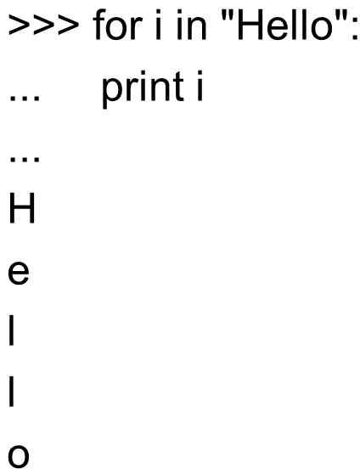
Strings are Sequences

Slide 23
Lists
We’ve seen lists before—that’s what range() returns.
Lists are very powerful structures.
Lists can contain strings, numbers, even other lists.
They work very much like strings
You get pieces out with []
You can add lists together
You can use for loops on them
We can use them to process a variety of kinds of data.

Slide 24
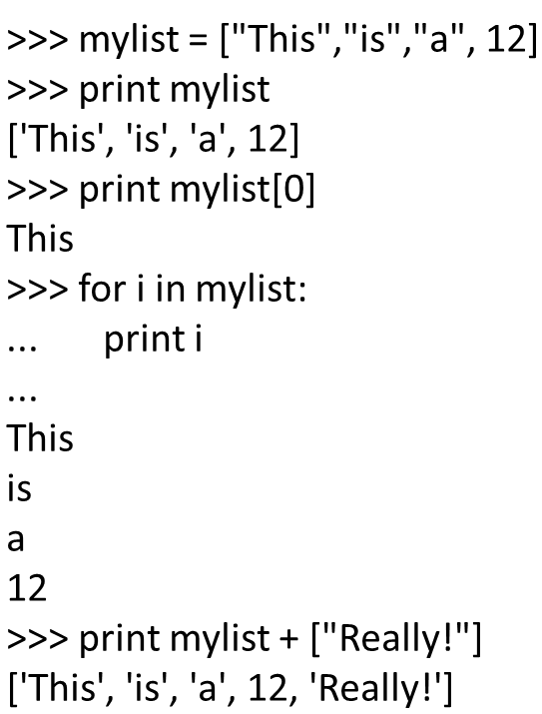
Demonstrating Lists

Slide 25
Useful Methods to Use with Lists: But These Don’t Work with Strings
append(something) puts something in the list at the end.
remove(something) removes something from the list, if it's there.
sort() puts the list in alphabetical order
reverse() reverses the list
count(something) tells you the number of times that something is in the list.
max() and min() are functions (we’ve seen them before) that take a list as input and give you the maximum and minimum value in the list.
Notes:
Do all of these in the command area

Slide 26
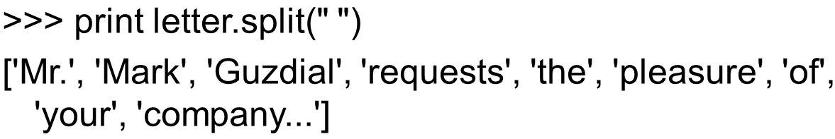
Converting from Strings to Lists

Slide 27
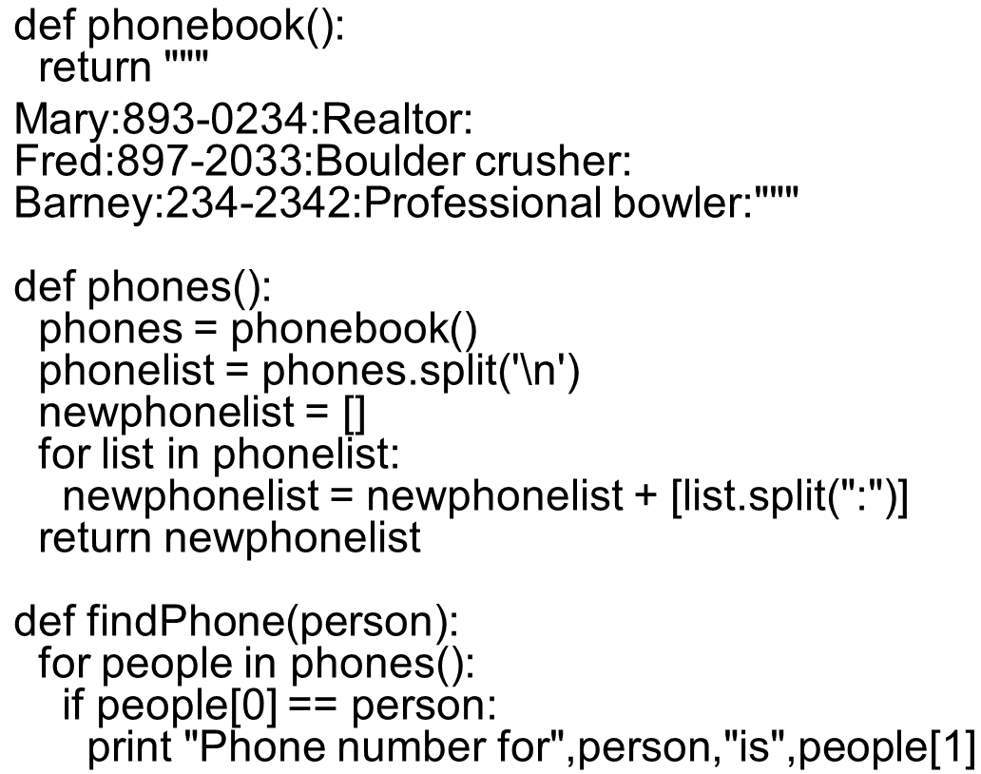
Extended Split Example

Slide 28
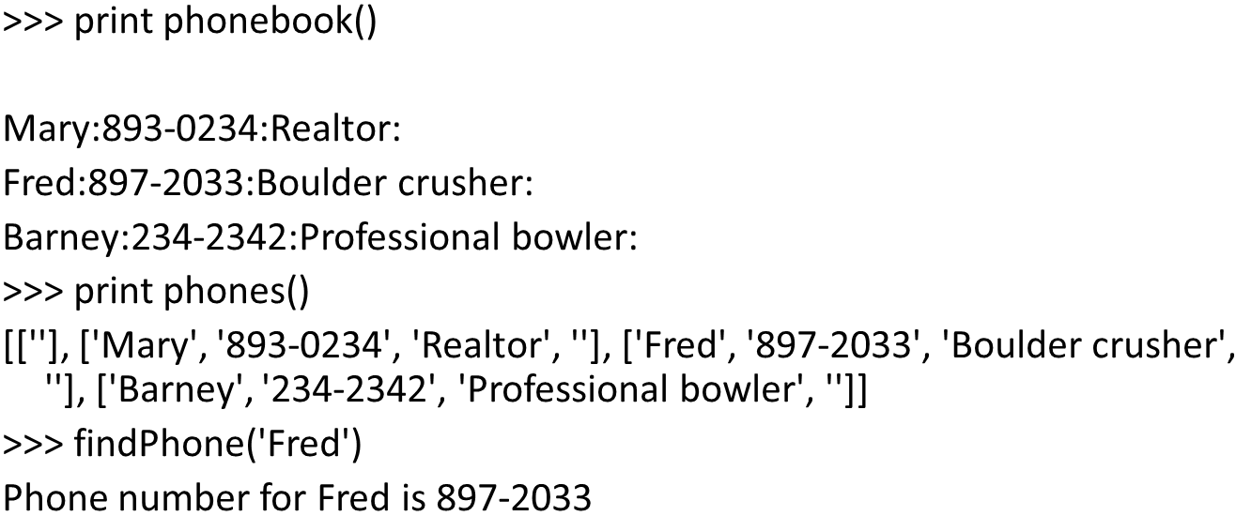
Running the Phonebook

Slide 29
Strings Have no Font
Strings are only the characters of text displayed “W Y S I W Y G” (What You See is What You Get)
W Y S I W Y G text includes fonts and styles
The font is the characteristic look of the letters in all sizes
The style is typically the boldface, italics, underline, and other effects applied to the font
In printer’s terms, each style is its own font

Slide 30
Encoding Font Information
Font and style information is often encoded as style runs
A separate representation from the string
Indicates bold, italics, or whatever style modification; start character; and end character.
The old brown fox runs.
Could be encoded as:
“The old brown fox runs.”
[[bold 0 6] [italics 5 12]]

Slide 31
How Do We Encode All That?
Is it a single value? Not really.
Do we encode it all in a complex list? We could.
How do most text systems handle this?
As objects
Objects have data, maybe in many parts.
Objects know how to act upon their data.
Objects’ methods may be known only to that object, or may be known by many objects, but each object performs that method differently.

Slide 32
What Can We Do with All This?
Answer: Just about anything!
Strings and lists are about as powerful as one gets in Python
By “powerful,” we mean that we can do a lot of different kinds of computation with them.
Examples:
Pull up a Web page and grab information out of it, from within a function.
Find a nucleotide sequence in a string and print its name.
Manipulate functions’ source
But first, we have to learn how to manipulate files…

Slide 33
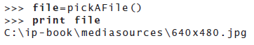
Files: Places to Put Strings and Other Stuff
Files are these named large collections of bytes.
Files typically have a base name and a suffix
barbara.jpg has a base name of “barbara” and a suffix of “.j p g”
Files exist in directories (sometimes called folders)
Tells us that the file “640×480.j p g” is in the folder “mediasources” in the folder “i p-book” on the disk “C:”

Slide 34
Directories
Directories can contain files or other directories.
There is a base directory on your computer, sometimes called the root directory
A complete description of what directories to visit to get to your file is called a path

Slide 35
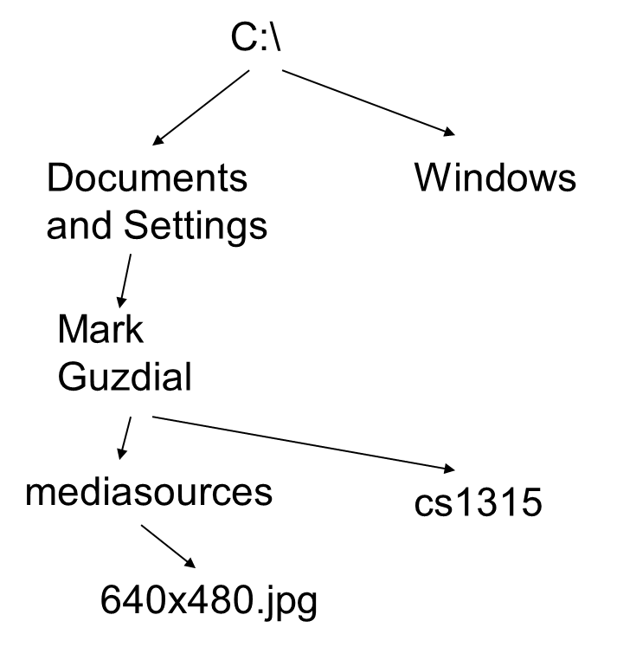
We Call This Structure A “Tree”
C:\ is the root of the tree.
It has branches, each of which is a directory
Any directory (branch) can contain more directories (branches) and files (leaves)

Slide 36
Why Do I Care About All This?
If you’re going to process files, you need to know where they are (directories) and how to specify them (paths).
If you’re going to do movie processing, which involves lots of files, you need to be able to write programs that process all the files in a directory (or even several directories) without having to write down each and every name of the files.

Slide 37
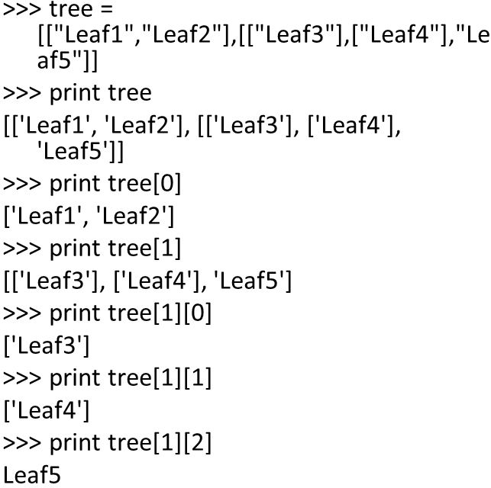
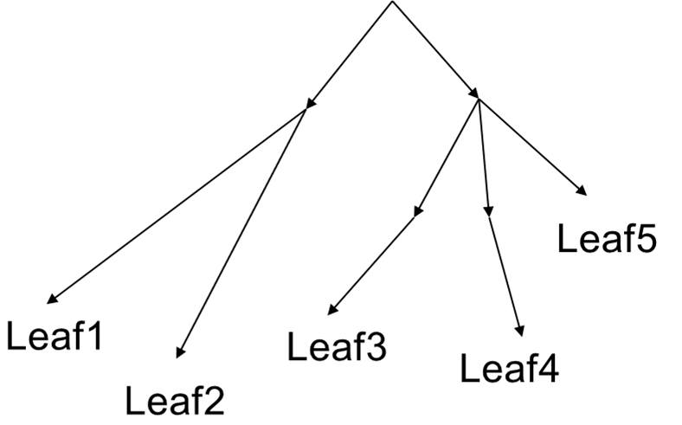
Using Lists to Represent
The Point: Lists allow us to represent complex relationships, like trees

Slide 38
How to Open a File
For reading or writing a file (getting characters out or putting characters in), you need to use open
open(filename,how) opens the filename.
If you don’t provide a full path, the filename is assumed to be in the same directory as J E S.
how is a two character string that says what you want to do with the string.
“rt” means “read text”
“wt” means “write text”
“rb” and “wb” means read or write bytes
We won’t do much of that

Slide 39
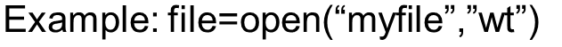
Methods on Files: Open Returns a File Object
open() returns a file object that you use to manipulate the file
file.read() reads the whole file as a single string.
file.readlines() reads the whole file into a list where each element is one line.
read() and readlines() can only be used once without closing and reopening the file.
file.write(something) writes something to the file
file.close() closes the file—writes it out to the disk, and won’t let you do any more to it without re-opening it.

Slide 40
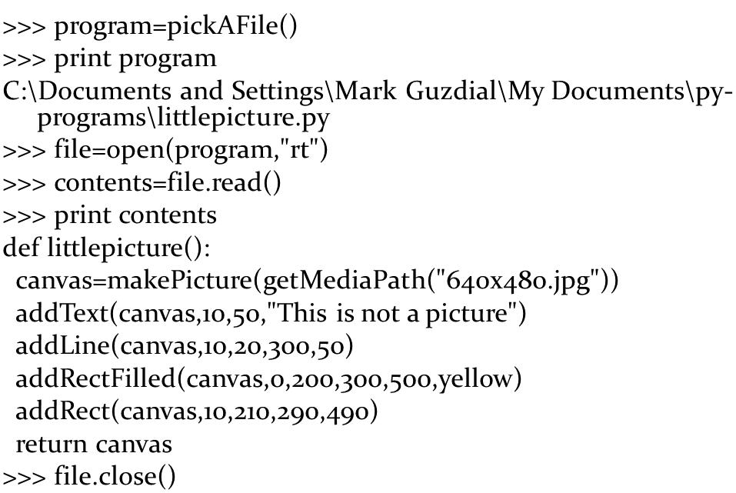
Reading a File

Slide 41
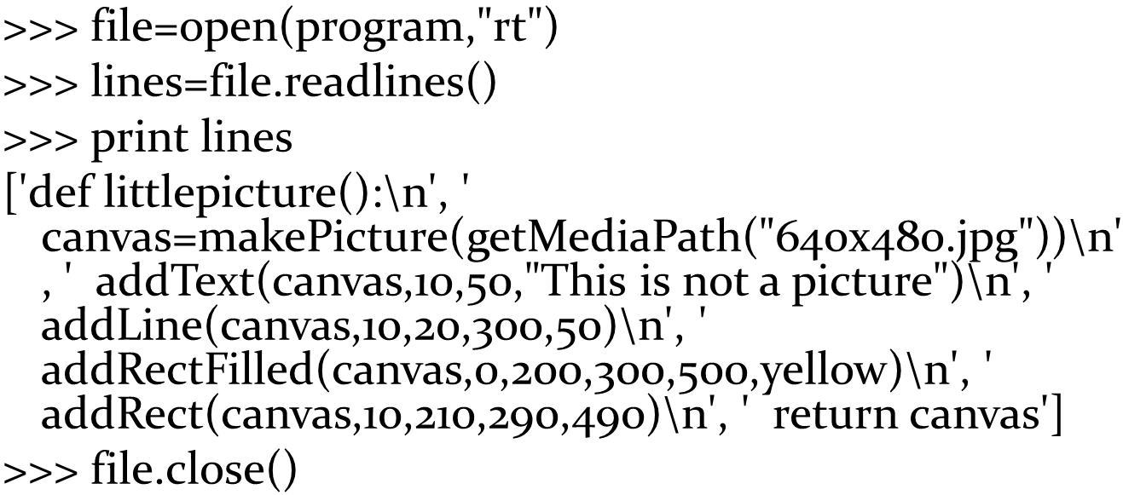
Reading a File by Lines

Slide 42
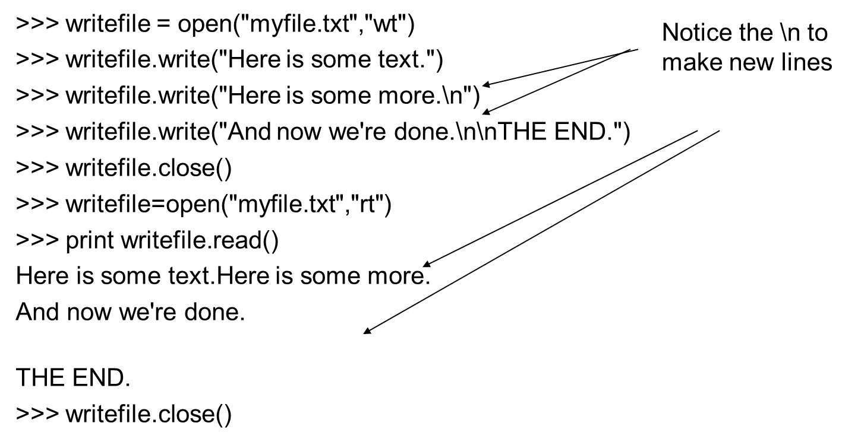
Silly Example of Writing a File

Slide 43
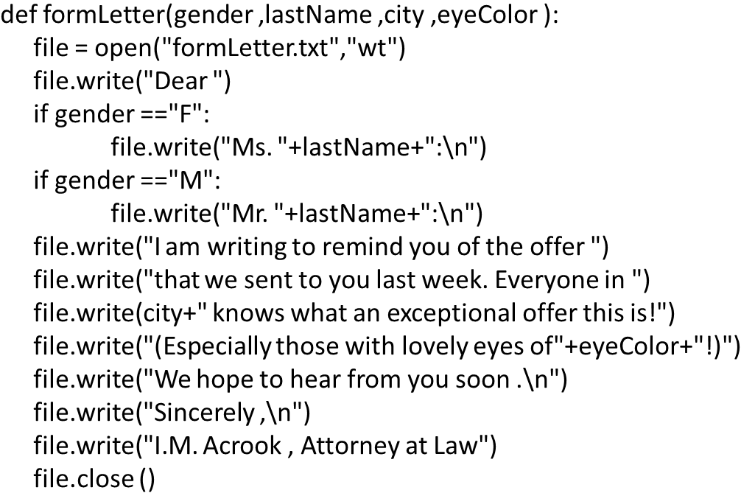
How You Get Spam

Slide 44
Trying out our spam generator
Dear Mr. Guzdial:
I am writing to remind you of the offer that we sent to you last week. Everyone in Decatur knows what an exceptional offer this is!(Especially those with lovely eyes of brown!)We hope to hear from you soon.
Sincerely,
I.M. Acrook,
Attorney at Law
Only use this power for good!

Slide 45
Writing a Program to Write Programs
First, a function that will automatically change the text string that the program “littlepicture” draws
As input, we’ll take a new filename and a new string.
We’ll find() the addText, then look for the first double quote, and then the final double quote.
Then we’ll write out the program as a new string to a new file.

Slide 46
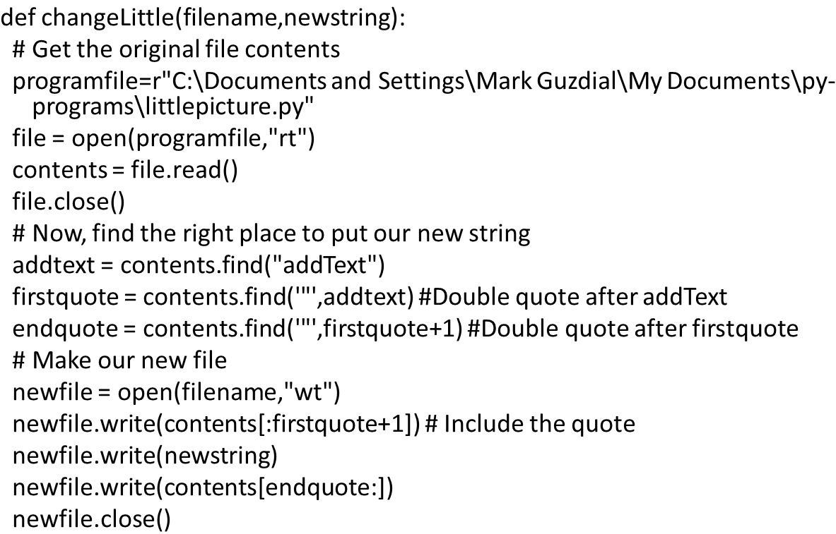
Changing the Little Program Automatically
Notes:
Be sure to walk through this at the command line

Slide 47
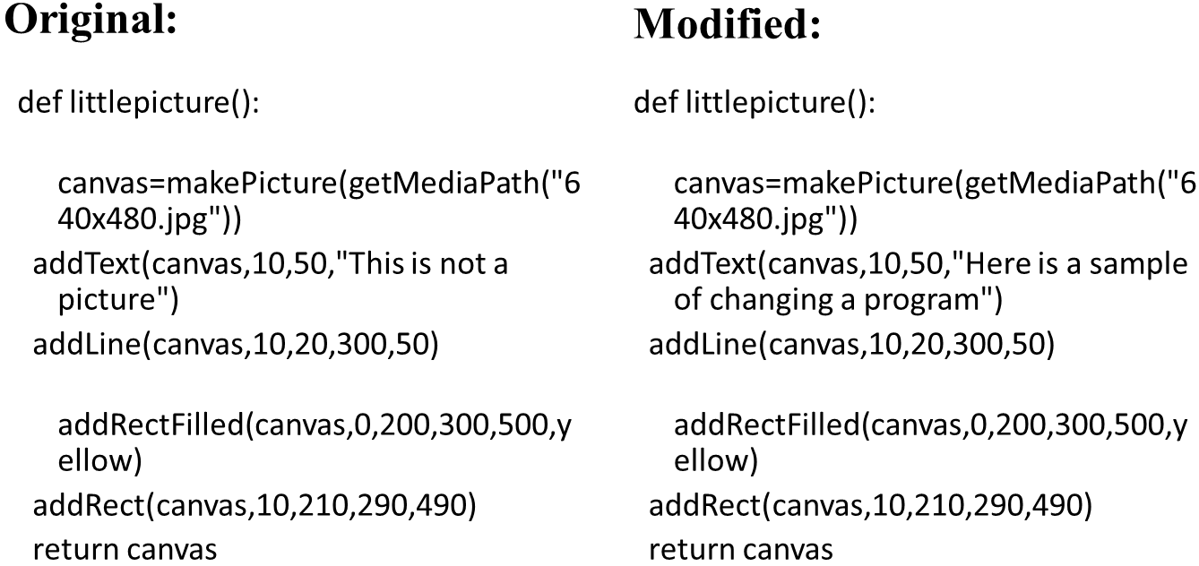
ChangeLittle(“Sample.py”, “Here is a Sample of Changing a Program”)

Slide 48
That’s How Vector-Based Drawing Programs Work!
Editing a line in AutoCAD doesn’t change the pixels.
It changes the underlying representation of what the line should look like.
It then runs the representation and creates the pixels all over again.
Is that slower?
Who cares? (Refer to Moore’s Law…)

Slide 49
Finding Data on the Internet
The Internet is filled with wonderful data, and almost all of it is in text!
Later, we’ll write functions that directly grab files from the Internet, turn them into strings, and pull information out of them.
For now, let’s assume that the files are on your disk, and let’s process them from there.

Slide 50
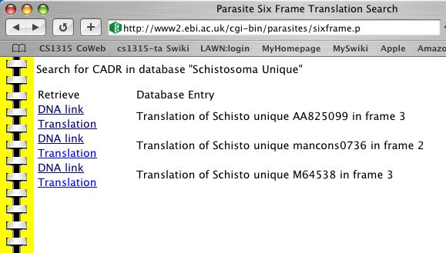
Example: Finding the Nucleotide Sequence
There are places on the Internet where you can grab D N A sequences of things like parasites.
What if you’re a biologist and want to know if a sequence of nucleotides that you care about is in one of these parasites?
What if you’re a biologist and want to know if a sequence of nucleotides that you care about is in one of these parasites?

Slide 51
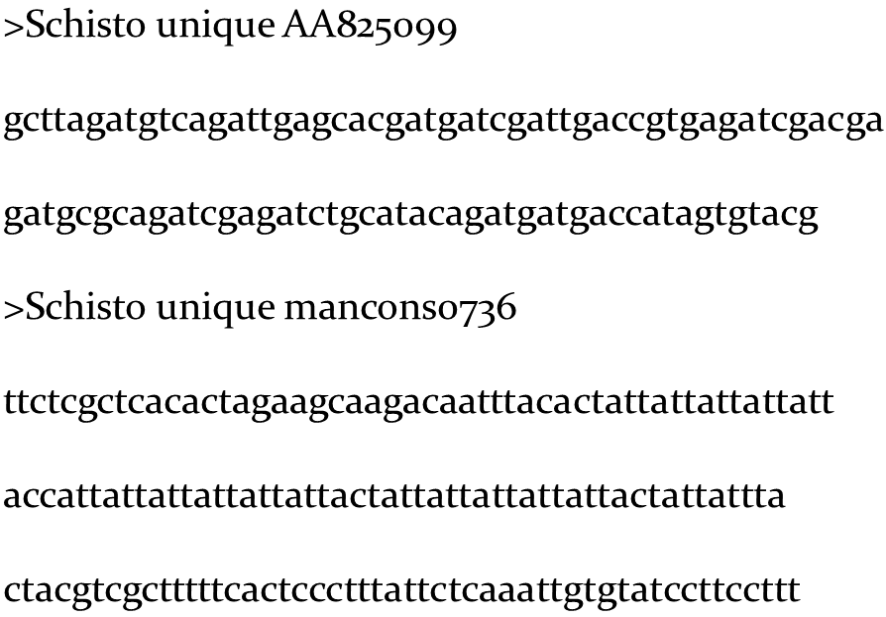
What the Data Looks Like

Slide 52
How Are We Going to Do It?
First, we get the sequences in a big string.
Next, we find where the small subsequence is in the big string.
From there, we need to work backwards until we find “>” which is the beginning of the line with the sequence name.
From there, we need to work forwards to the end of the line. From “>” to the end of the line is the name of the sequence
Yes, this is hard to get just right. Lots of debugging prints.

Slide 53
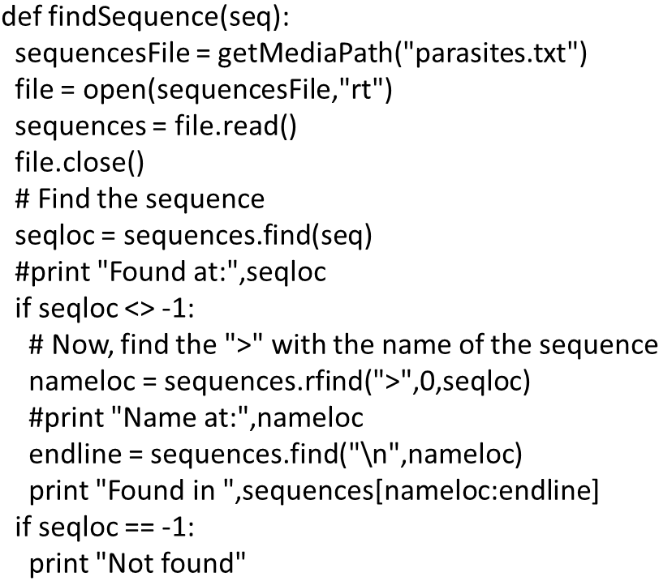
The Code That Does It

Slide 54
Why −1?
If .find or .rfind don’t find something, they return -1
If they return 0 or more, then it’s the index of where the search string is found.
What’s “<>”?
That’s notation for “not equals”
You can also use “!=“

Slide 55
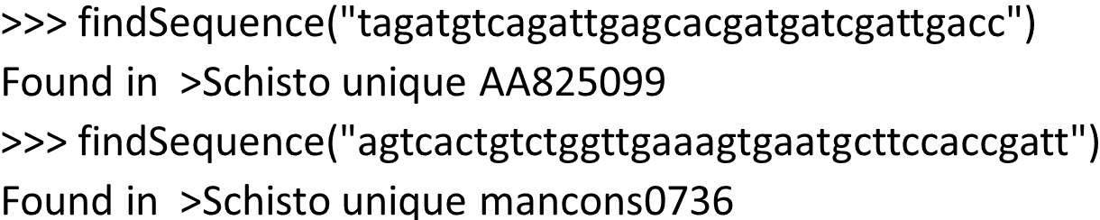
Running the Program

Slide 56
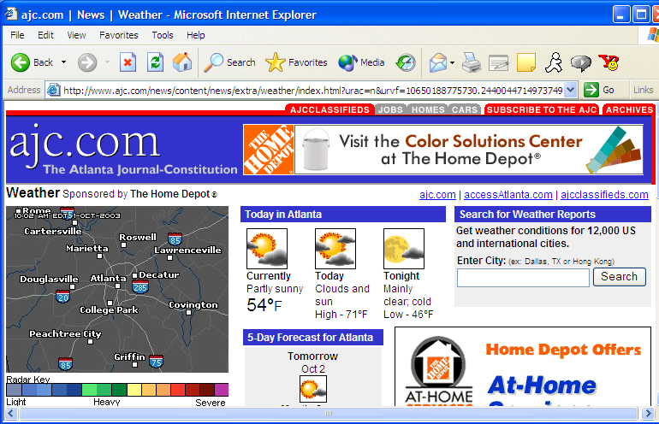
Example: Get the Temperature
The weather is always available on the Internet.
Can we write a function that takes the current temperature out of a source like http://www.ajc.com/weather or http://www.weather.com?

Slide 57
The Internet is Mostly Text
Text is the other unimedia.
Web pages are actually text in the format called H T M L (HyperText Markup Language)
H T M L isn’t a programming language, it’s an encoding language.
It defines a set of meanings for certain characters, but one can’t program in it.
We can ignore the H T M L meanings for now, and just look at patterns in the text.

Slide 58
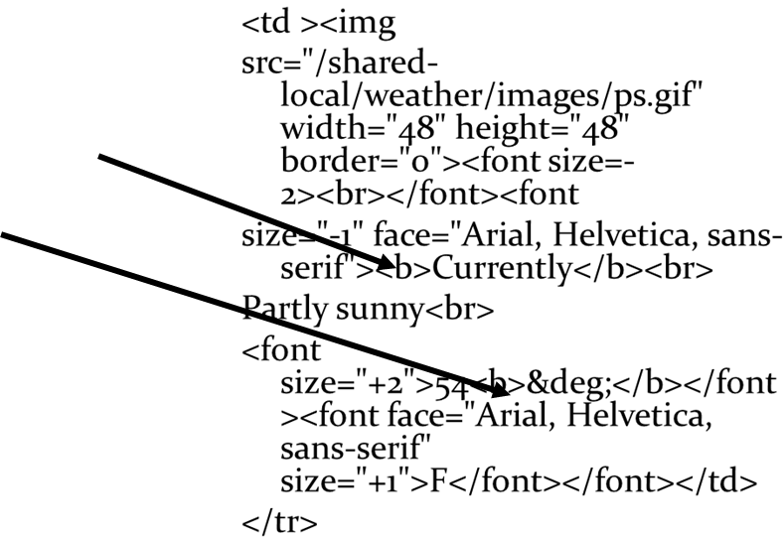
Where’s the Temperature?
The word “temperature” doesn’t really show up.
But the temperature always follows the word “Currently”, and always comes before the

Slide 59
We Can Use the Same Algorithm We’ve Seen Previously
Grab the content out of a file in a big string.
(We’ve saved the H T M L page previously.
Soon, we’ll see how to grab it directly.)
Find the starting indicator (“Currently”)
Find the ending indicator
Read the previous characters

Slide 60
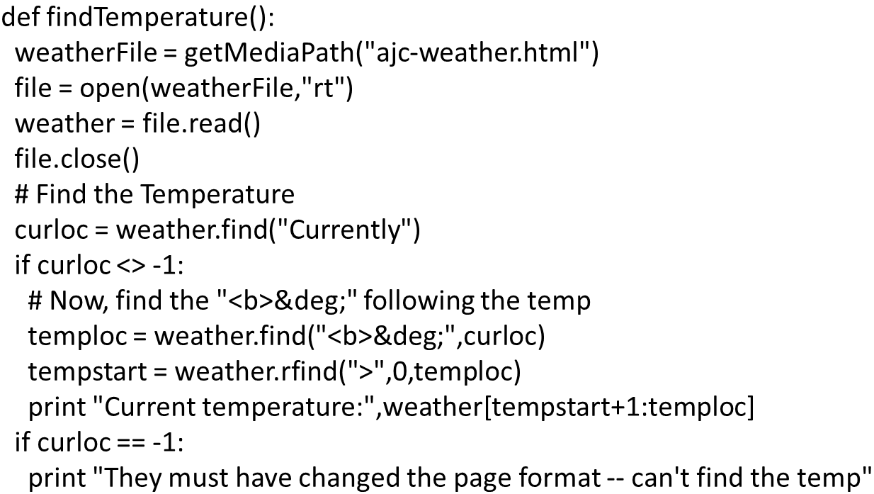
Finding the Temperature

Slide 61
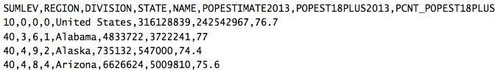
C S V Data
There are many places on the Internet where you can find data in comma-separated values (C S V) format.
Do a Web search for “data journalism”
Or try the U S Census at https://www.census.gov
(Also provided in state-populations.csv in MediaSources at http://mediacomputation.org)

Slide 62
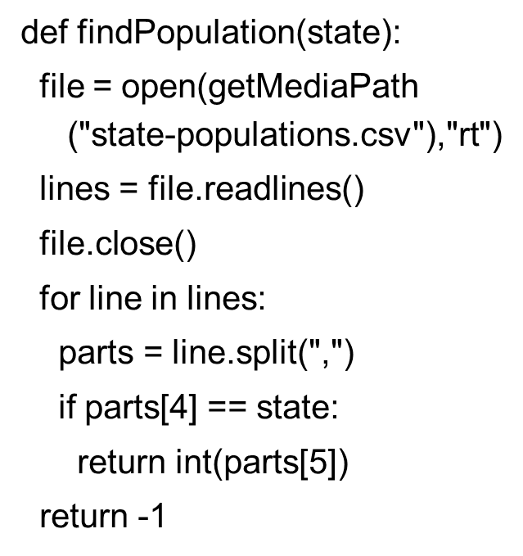
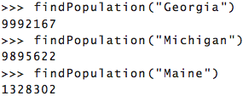
Find a State’s Population

Slide 63
Adding New Capabilities: Modules
What we need to do is to add capabilities to Python that we haven’t seen so far.
We do this by importing external modules.
A module is a file with a bunch of additional functions and objects defined within it.
Some kind of module capability exists in virtually every programming language.
By importing the module, we make the module’s capabilities available to our program.
Literally, we are evaluating the module, as if we’d typed them into our file.

Slide 64
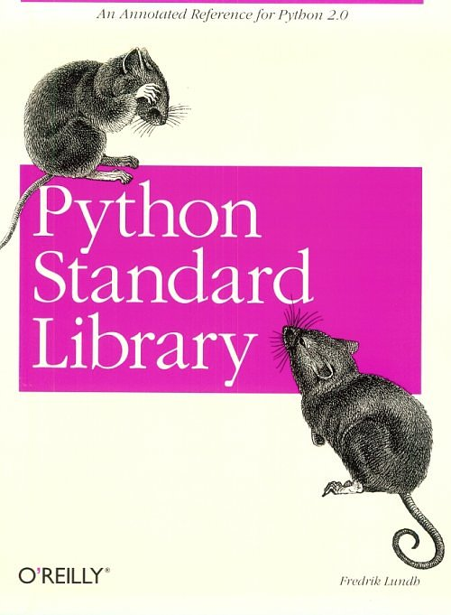
Python’s Standard Library
Python has an extensive library of modules that come with it.
The Python standard library includes modules that allow us to access the Internet, deal with time, generate random numbers, and…access files in a directory.

Slide 65
Accessing Pieces of a Module
We access the additional capabilities of a module using dot notation, after we import the module.
How do you know what pieces are there?
Check the documentation.
Python comes with a Library Guide.
There are books like Python Standard Library that describe the modules and provide examples.

Slide 66
The O S Module
The O S module offers a number of powerful capabilities for dealing with files, e.g., renaming files, finding out when a file was last modified, and so on.
We start accessing the O S module by typing:
import o s
The function that knows about directories is listdir(), used as o s.listdir()
listdir takes a path to a directory as input.

Slide 67
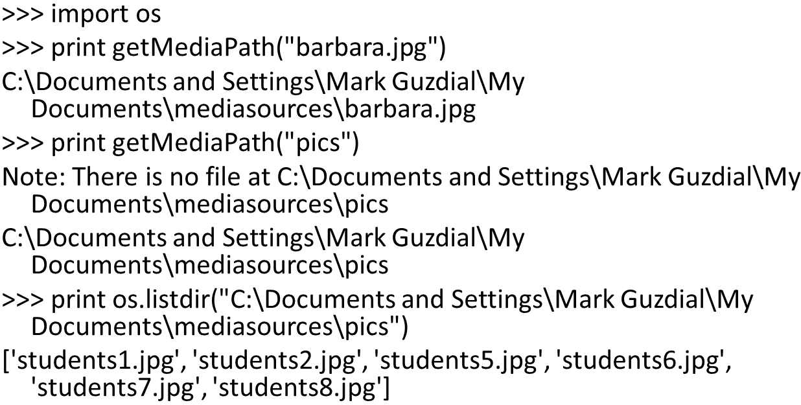
Using o s.listdir

Slide 68
Writing a Program to Title Pictures
We’ll input a directory
We’ll use o s.listdir() to get each filename in the directory
We’ll open the file as a picture.
We’ll title it.
We’ll save it out as “titled-” and the filename.

Slide 69
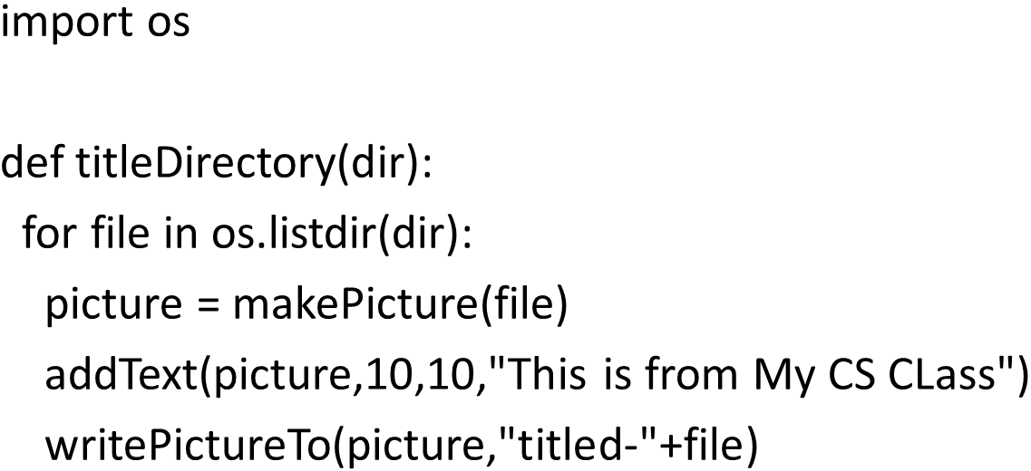
Titling Pictures

Slide 70
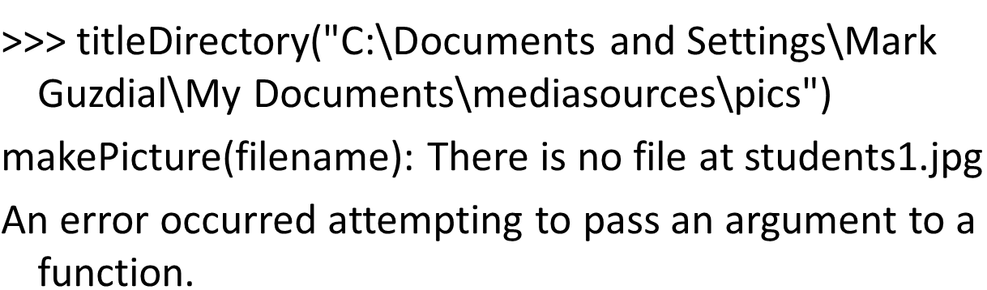
Okay, That Didn’t Work

Slide 71
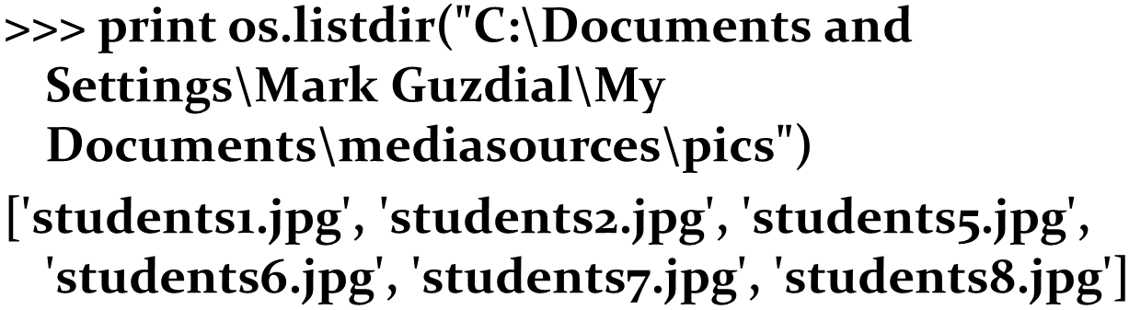
Why Not?
Is there a file where we tried to open the picture?
Actually, no. Look at the output of o s.listdir() again
The strings in the list are just the base names
No paths

Slide 72
Creating Paths
If the directory string is in the placeholder variable dir, then dir+file is the full pathname, right?
Close—you still need a path delimiter, like “/”
But it’s different for each platform!
Python gives us a notation that works: “//” is as a path delimiter for any platform.
So: dir+“//”+file

Slide 73
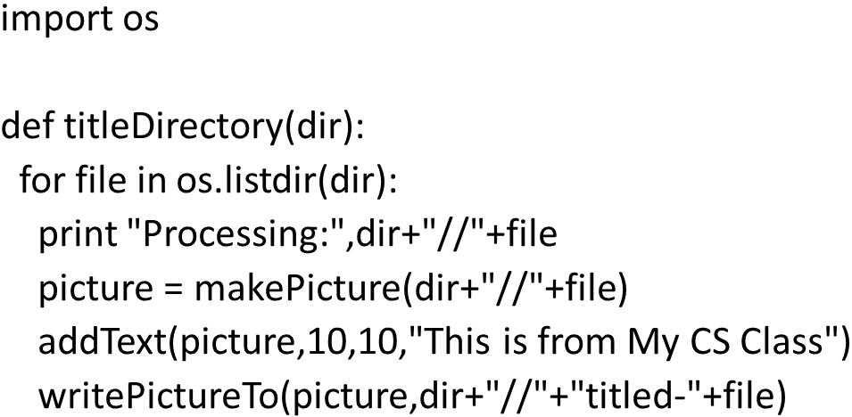
A Working Titling Program

Slide 74
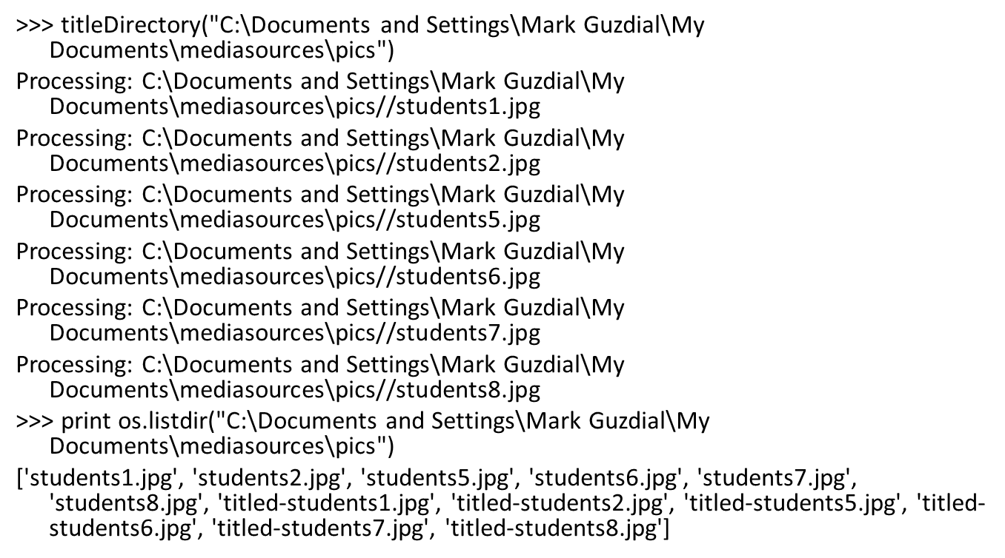
Showing It Work

Slide 75

Inserting a Copyright on Pictures

Slide 76
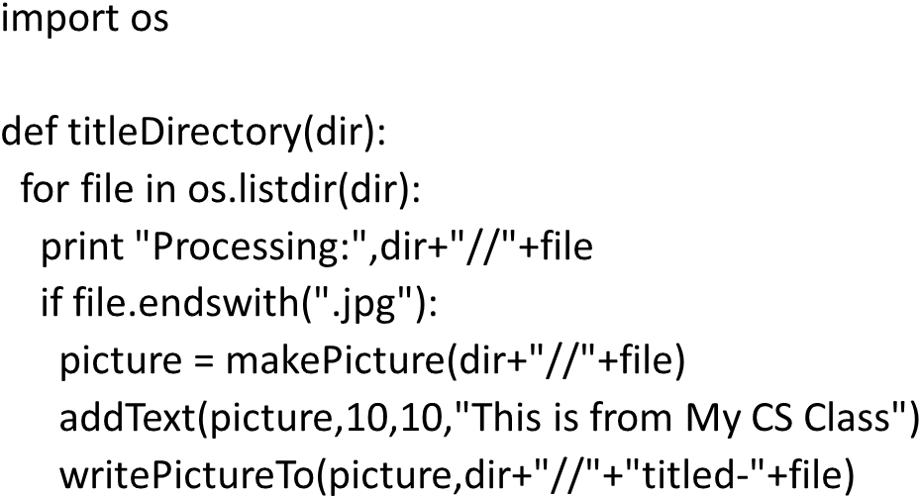
What if You Want to Make Sure You’ve Got J P E G Files?

Slide 77

Say, if thumbs.db is There

Slide 78

Another Interesting Module: Random

Slide 79

Randomly Choosing Words from a List

Slide 80
Randomly Generating Language
Given a list of nouns, verbs that agree in tense and number, and object phrases that all match the verb,
We can randomly take one from each to make sentences.

Slide 81

Random Sentence Generator

Slide 82

Running the Sentence Generator

Slide 83

How Much Smarter Can We Make This?
Can we have different kinds of lists so that, depending on the noun selected, picks the right verb list to get a match in tense and number?
How about reading input from the user, picking out key words, then generating an “appropriate response”?
Notes:
Demo eliza here.

Slide 84
Joseph Weizenbaum’s “Eliza”
Created a program that acted like a Rogerian therapist.
Echoing back to the user whatever they said, as a question.
It had rules that triggered on key words in the user’s statements.
It had a little memory of what it had said before.
People really believed it was a real therapist!
Convinced Weizenbaum of the dangers of computing.

Slide 85

Session with The “Doctor”
Note that this is all generated automatically.

Slide 86

Many Other Python Standard Libraries
datetime and calendar know about dates.
What day of the week was the U S Declaration of Independence signed? Thursday.
math knows about sin() and s q r t()
zipfile knows how to make and read .zip files
email lets you (really!) build your own spam program, or filter spam, or build an email tool for yourself.
Simple H T T P Server is a complete working Web server.

Slide 87

Copyright

